Slide 1
OpenShift Overview

Slide 2
Agenda
What is OpenShift
Why OpenShift
Features
OpenShift Architecture
Basic Concept
Getting Started with Creating New Application
Build Automation
Application Scaling
Deployment Strategies
Docker and Kubernetes

Slide 3
What is OpenShift
OpenShift is a cloud development Platform as a Service (PaaS) hosted by Red Hat. It’s an open source cloud-based user-friendly platform used to create, test, and run applications, and finally deploy them on cloud.
OpenShift is capable of managing applications written in different languages, such as Node.js, Ruby, Python, Perl, and Java. One of the key features of OpenShift is it is extensible, which helps the users support the application written in other languages.

Slide 4
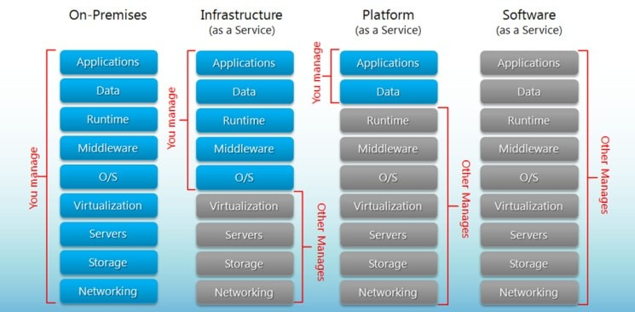
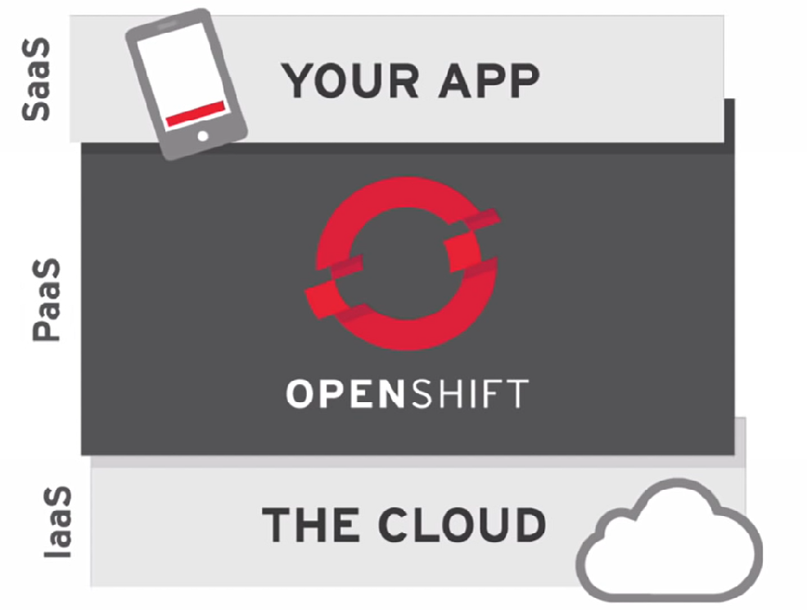
IaaS vs PaaS vs SaaS

Slide 5
Why to use OpenShift
OpenShift provides a common platform for enterprise units to host their applications on cloud without worrying about the underlying operating system. This makes it very easy to use, develop, and deploy applications on cloud.
One of the key features is, it provides managed hardware and network resources for all kinds of development and testing. With OpenShift, PaaS (Platform as a Service) developer has the freedom to design their required environment with specifications.

Slide 6
Features
Multiple Language Support
Multiple Database Support
Extensible Cartridge System
Source Code Version Management
One-Click Deployment
Multi Environment Support
Standardized Developers’ workflow
Dependency and Build Management
Automatic Application Scaling
Responsive Web Console
Rich Command-line Toolset
Remote SSH Login to Applications
Rest API Support
Self-service On Demand Application Stack
Built-in Database Services
Continuous Integration and Release Management
IDE Integration
Remote Debugging of Applications

Slide 7
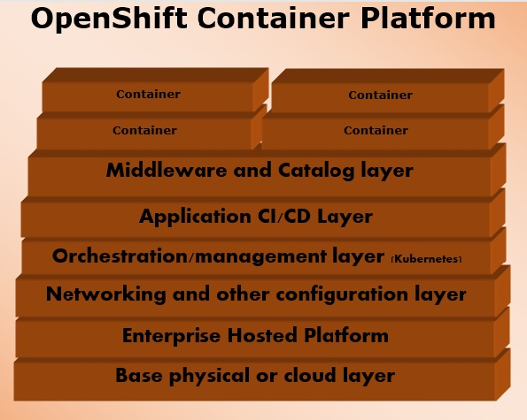
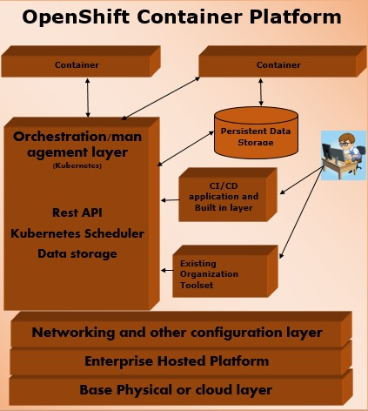
OpenShift Architecture

Slide 8
Basic Concept
Containers and Images
Pods and Services
Builds and Streams
Routes and Templates
Authentication and Authorization

Slide 9
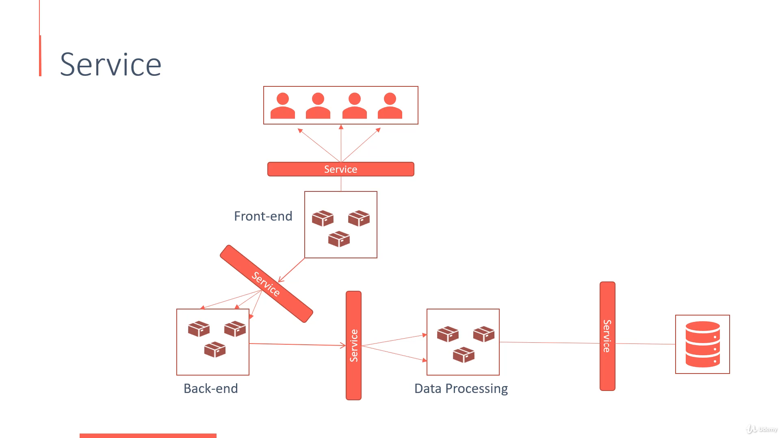

Slide 10
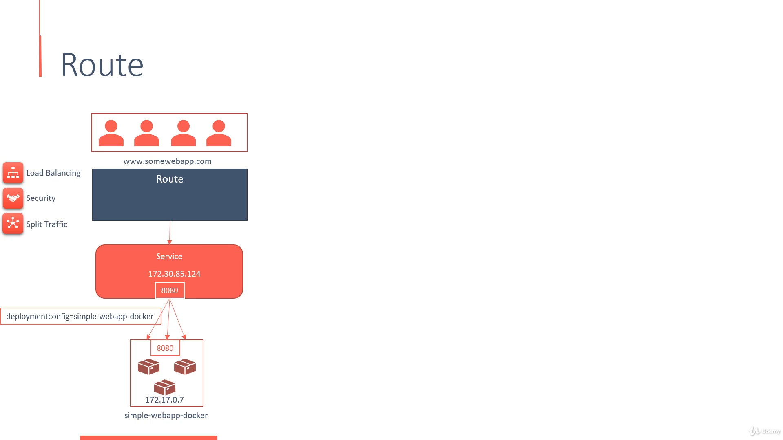

Slide 11
Creating New Application
OpenShift consists of two types of medians to create and deploy applications, either by GUI or by CLI.
In OpenShift, there are 3 methods of creating a new application.
From a source code
From an image
From a template

Slide 12
Build Automation
In OpenShift, we have multiple methods of automating the build pipeline. In order to do that we need to create a BuildConfig resource to describe the build flow. The flow in BuildConfig can be compared with the job definition in Jenkins job definition. While creating the build flow, we have to choose the build strategy.
In OpenShift, there are four types of build strategies.
Source-to-image strategy
Docker strategy
Custom strategy
Pipeline strategy

Slide 13
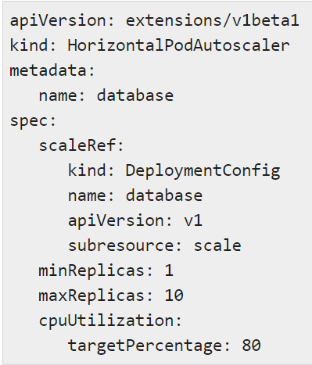


Application Scaling
Autoscaling is a feature in OpenShift where the applications deployed can scale and sink as and when required as per certain specifications
There are two types of application scaling :
Vertical Scaling
Horizontal Scaling
Using Deployment Configuration File
While Running the Image

Slide 14
Deployment Strategies
Deployment strategy in OpenShift defines a flow of deployment with different available methods
following are the important types of deployment strategies
Rolling strategy
Recreate strategy
Custom strategy

Slide 15
Docker and Kubernetes
OpenShift is built on top of Docker and Kubernetes. All the containers are built on top of Docker cluster, which is basically Kubernetes service on top of Linux machines, using Kubernetes orchestrations feature.
In this process, we build Kubernetes master which controls all the nodes and deploys the containers to all the nodes. The main function of Kubernetes is to control OpenShift cluster and deployment flow using a different kind of configuration file. As in Kubernetes, we use kubectl in the same way we use OC command line utility to build and deploy containers on cluster nodes.

Slide 16
THANK YOU

